Slide 1
Team
∞
Brief, requirements, effort estimates, solution Outline (specs)

Slide 2
Requirements (v4)
Must have
M1: The process must find the closest exchange to a customer home address and display the id and location of said exchange.
M2: The distance must be calculated for each exchange and to find the closest using a grid pattern
M3: Each exchange must be defined by a unique identifier of the form ex:p:q where p and q are numbers between 0 and 9
M4: Must accept user input to specify grid dimensions (x & y independently) equal or greater than 0 and equal or less than 100,000.
M5: Customer must be at (0,0)
M6: The user must be able to input the id and the location of the exchange
M7: The process must display a grid at the end containing the customer and the exchanges
M8: Each cell containing an exchange must always display its id and the distance from the customer
M9: User must be able to input up to 99 unique exchanges
M10: User must be able to input the current capacity of a given exchange

Slide 3
Assumptions
Assumptions
Assumed that the grid x and y are inputted independently
Assume that the exchange can be on the same coordinate as the home address.
Assume that the exchanges cannot have the same coordinates
Used by the CSR (Customer service representative)
Distance is measured by horizontal/vertical units not Pythagorean distance
Simpler
Cables in the real world don’t go direct
Assume exchanges can be inputted individually as opposed to in bulk
Assume that capacity can be used to determine which equidistant exchange is to be displayed at the end
Assume that capacity doesn’t need to be shown on the final grid UI

Slide 4
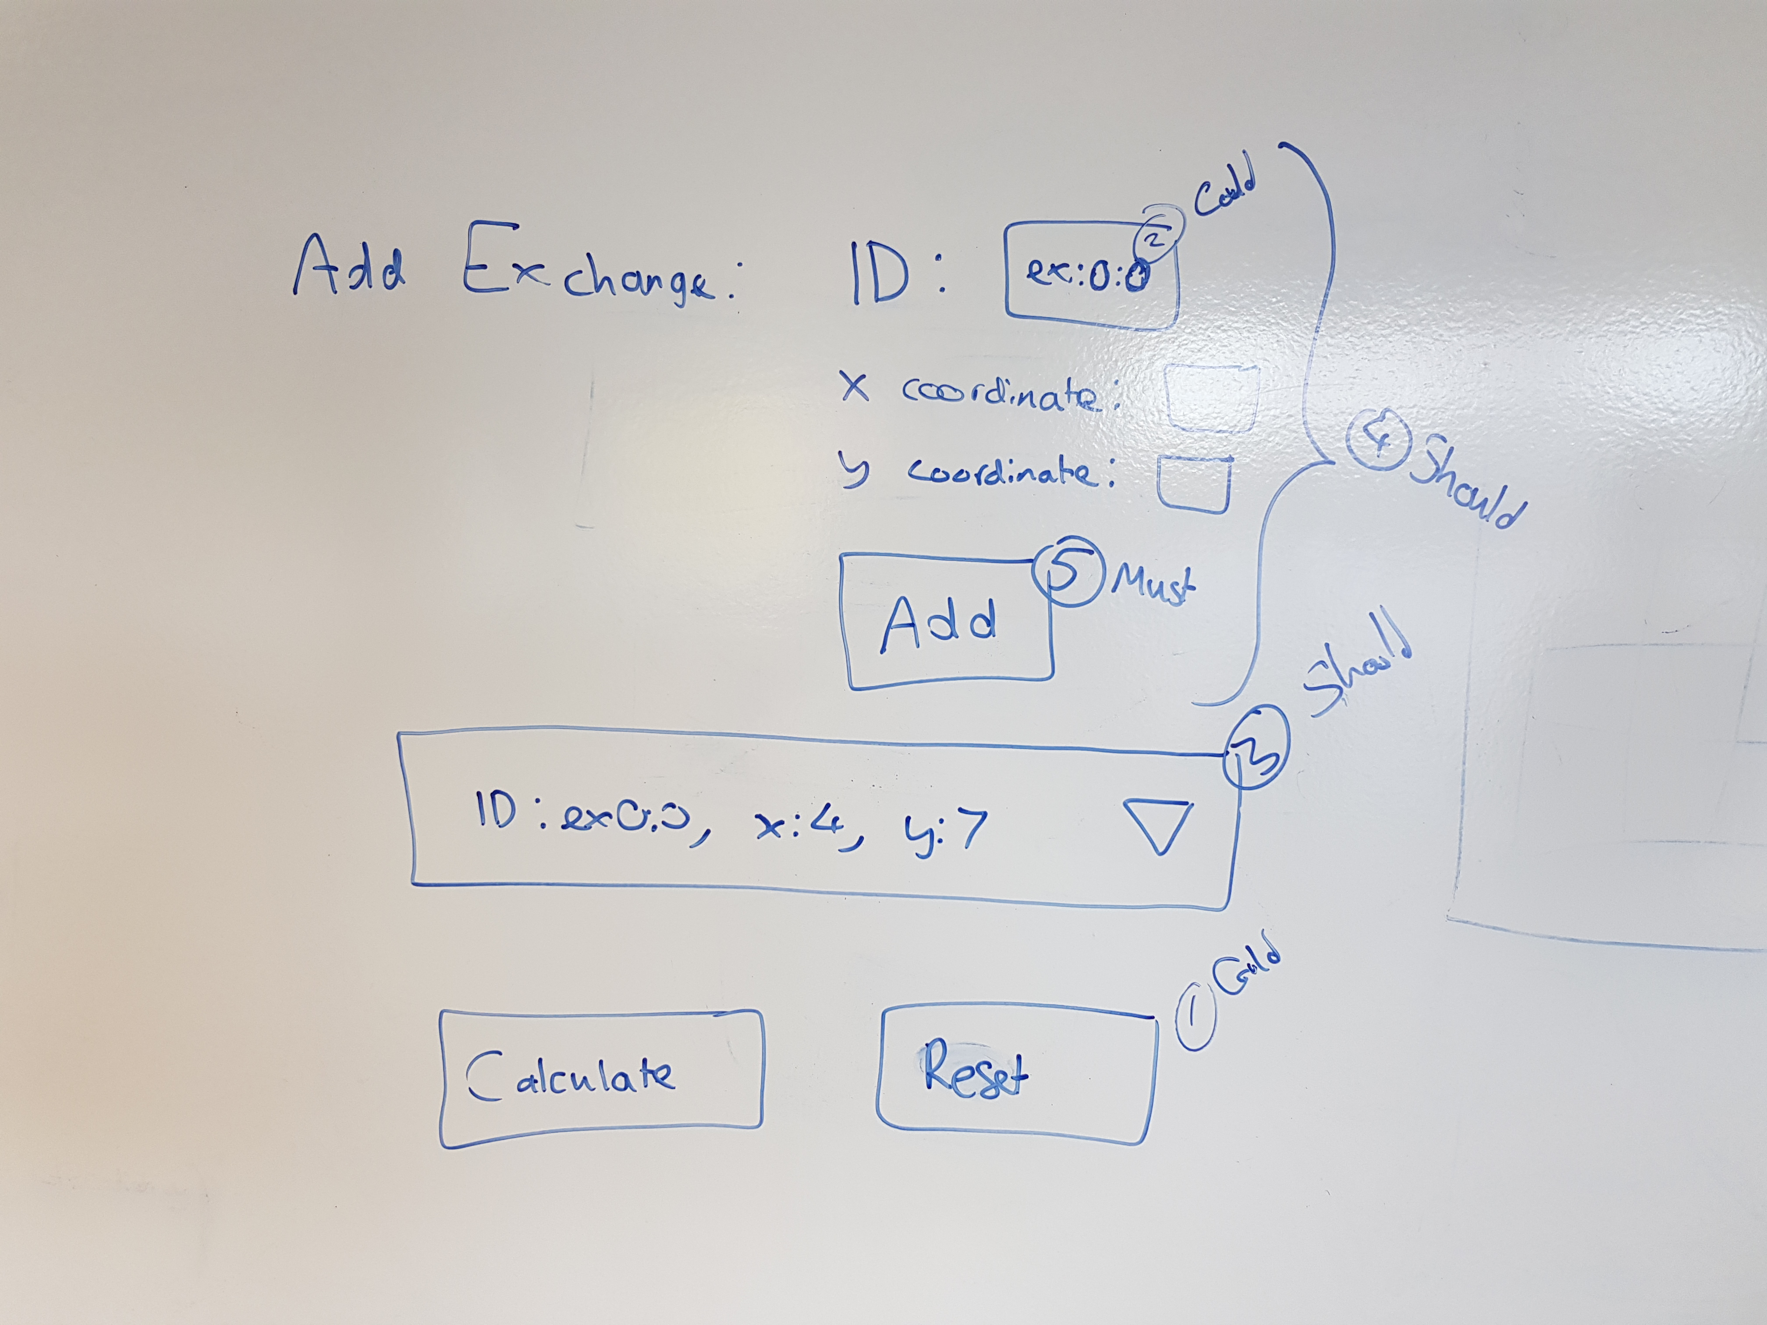
UI (v4)
Capacity:

Slide 5
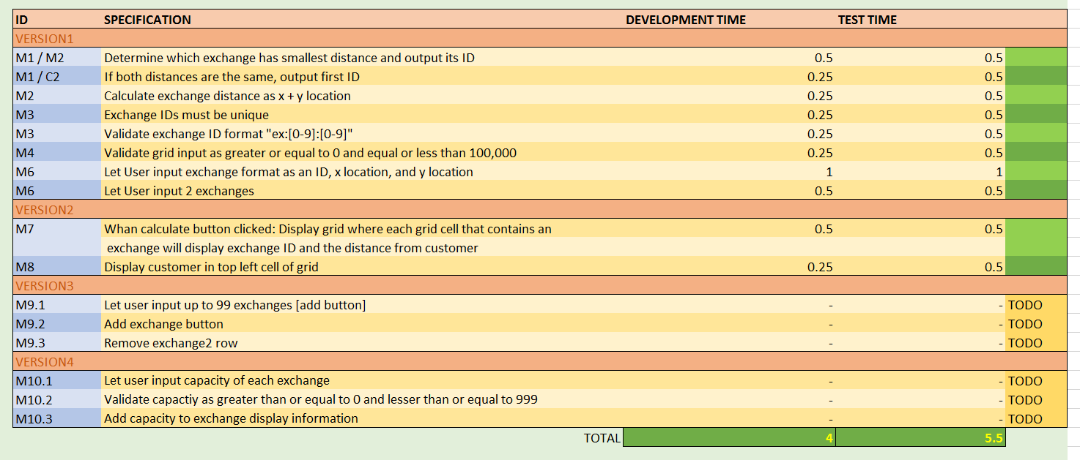
Specifications: Development & Testing and effort estimates

Slide 6
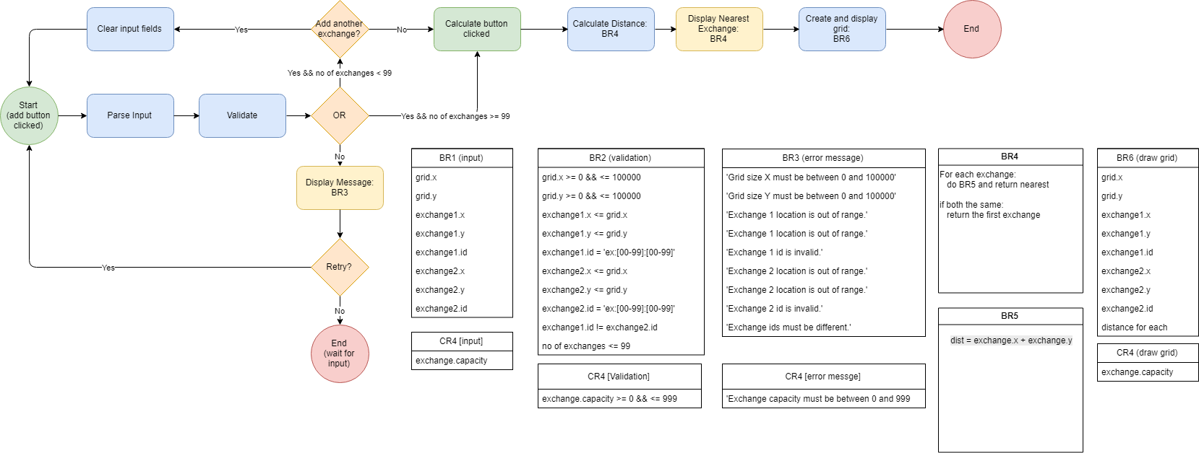
Flow Diagram (v4)

Slide 7
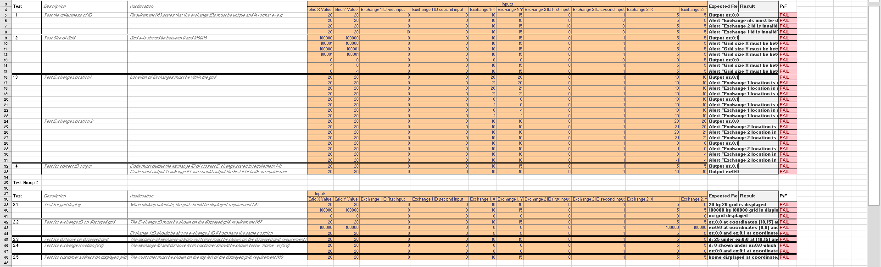
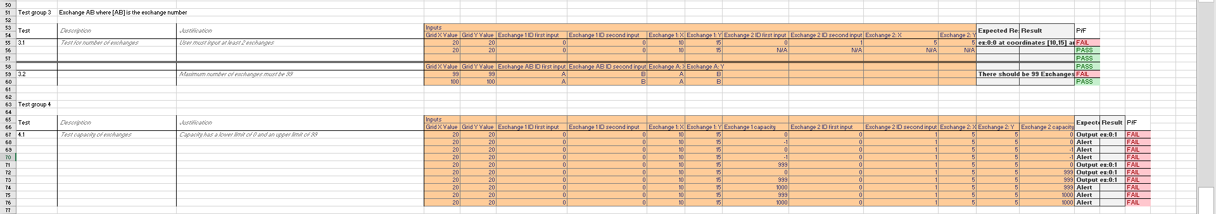
Testing

